Slide 1
Step 1: Formatting Rat Data Folders

Slide 2
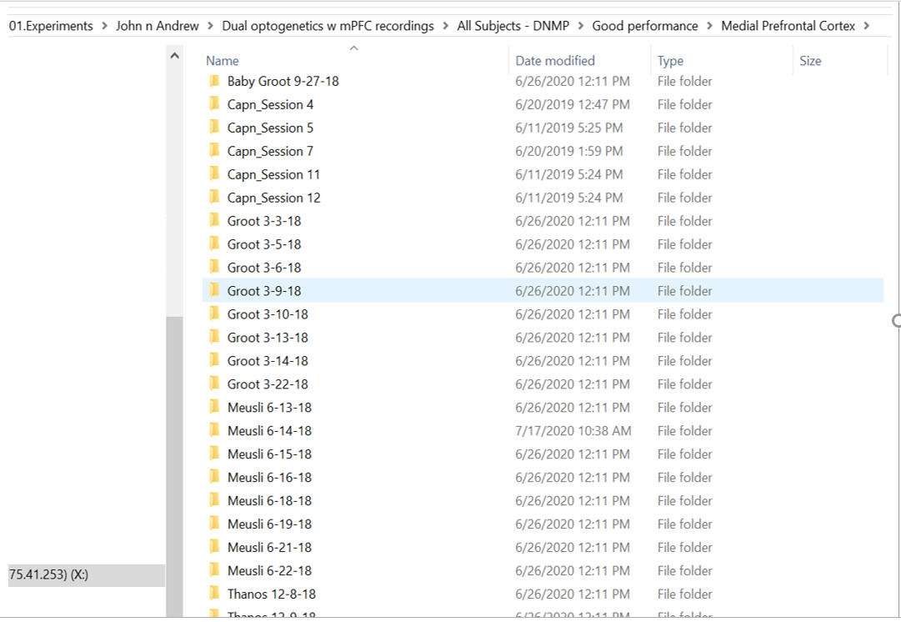
Here is an example. Notice how all rats are stored together. The organization of this data makes it easy to perform any sort of averaging that you want (ie average across sessions, average across rats, average within rats).
Note that not all code in the folder is created to average in anyway you choose. However, you can select which sessions to extract data from. For example, when you run certain functions, you’ll be required to enter if you’d like to change the ‘Looping Index’. If you say ‘Y’, then you must enter which rats to look at.

Slide 3
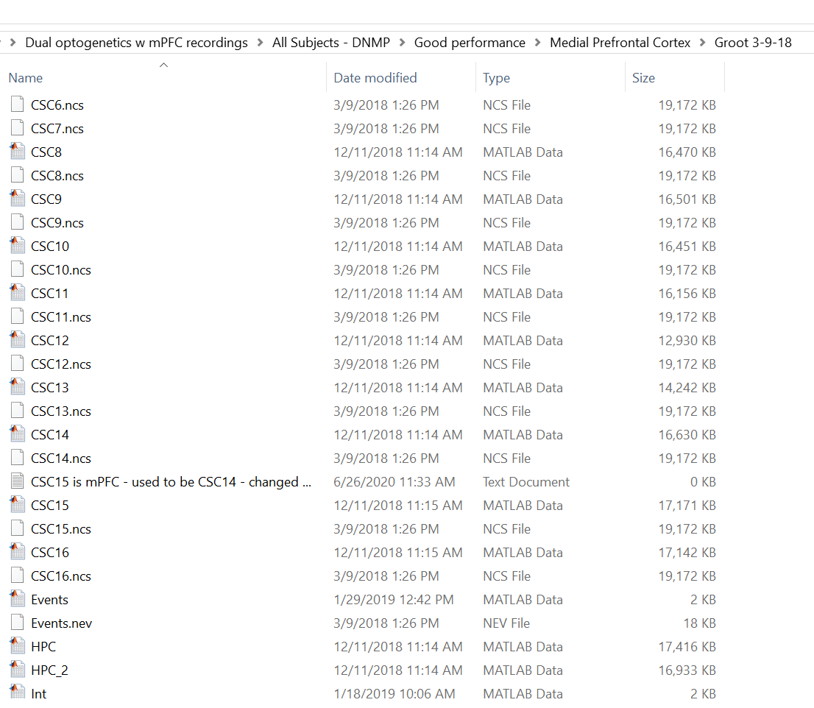
This is the inside of a ‘datafolder’
The ‘datafolder’ is a matlab variable name used to refer to the contents of a session (ie the data).

Slide 4
Step 2: Initialize Matlab

Slide 5
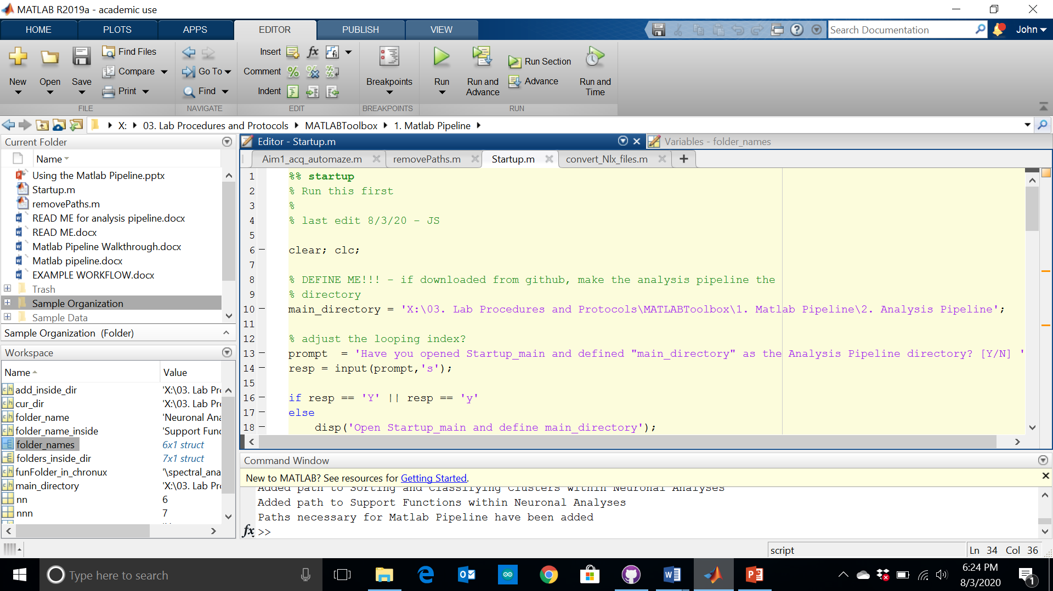
Run ‘Startup’ after you define the ‘main_directory’ variable. This variable should reflect the directory (i.e. the location in your folders) of the ‘Analysis Pipeline’ folder.
This was designed so that you can download this code from github with no attachments to specific directories. Note that ‘removePaths’ does the opposite of ‘Startup’

Slide 6
Step 3: Converting and Formatting Data

Slide 7
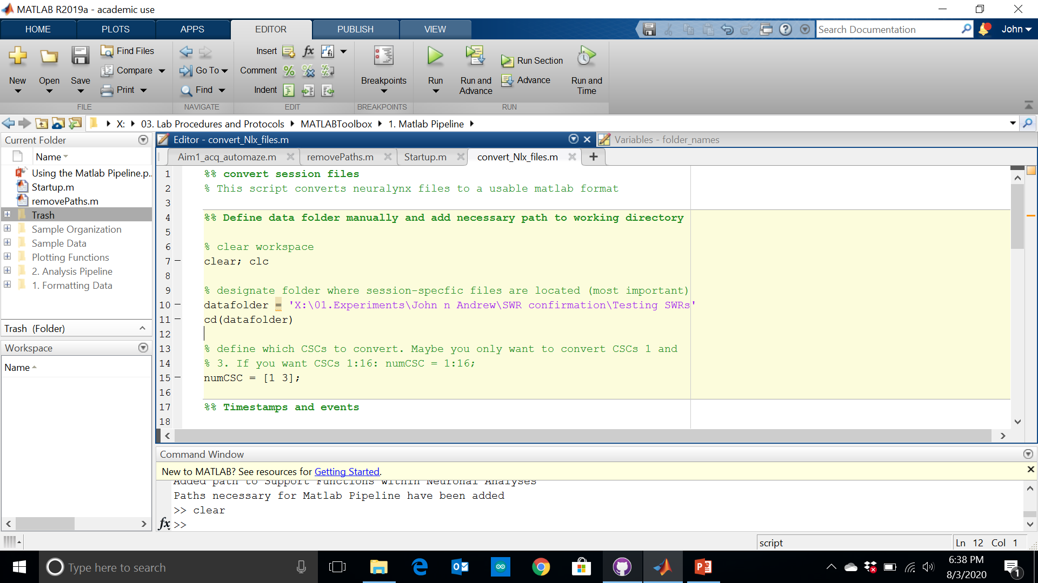
Convert video tracking data, events, and LFP using the ‘convert_Nlx_files’ script.
Make sure to define your ‘datafolder’. This is the directory where your data is stored (see slide 3). Note that before this file, you will most likely have no .mat files. After converting, you’ll have .mat files
Before running, define which CSCs to convert. This variable name is ‘numCSC’

